Slide 1
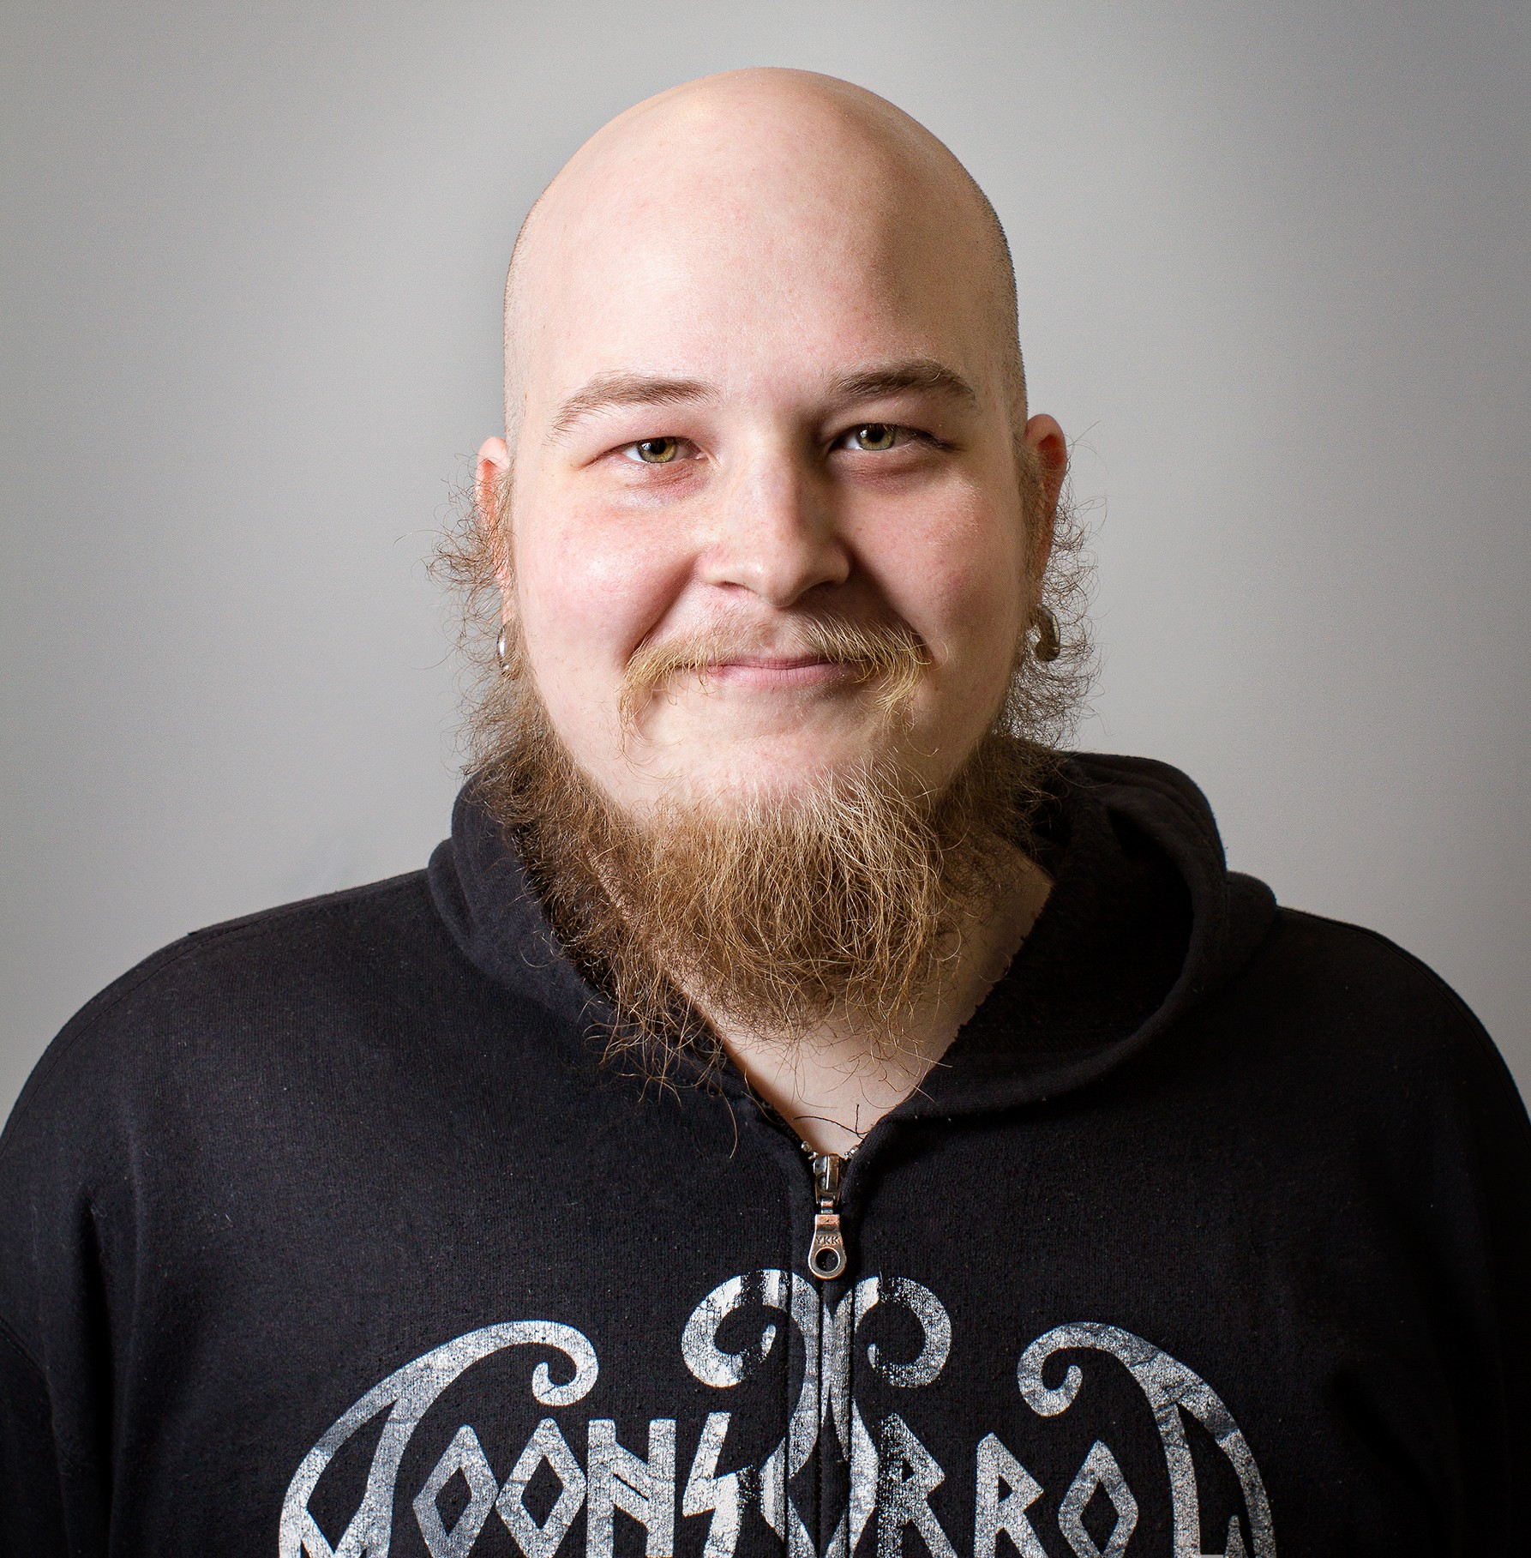
Harri (31)
System administrator for the city of Oulu
Nationality: Finnish
Harri is single and lives in a flat in Oulu.
Harri drives Chevrolet Monte Carlo from 1972. He also owns a Harley Davidson.
His preferred operating system is any Unix-based operating system. He has a Thinkpad laptop and a Xiaomi phone.
“Visualize all the things!”

Slide 2
Motivation
Harri is motivated by keeping everything running, detecting issues before they become problems.
Challenges
Harri is introverted: prefers to work in a calm environment by himself. Harri prefers written communication, because he wants to be able to weigh all the alternatives before making an informed decision.
Appreciates
Harri appreciates philosophical discussions with close friends and wants to relax by spending time by himself.
Fears
Harri doesn’t want to be the center of attention and fears having to give presentations to large audiences.
Hobbies
Harri listens to black metal and plays base in a garage band.
He also enjoys tinkering with his Harley Davidson.
APINF considerations
Harri works to keep things stable and secure:
Prefers to have everything running smoothly
Dashboard graphs and charts should give him detailed information about usage of their API’s
Needs to be able to cut API usage, if there are malicious attempts or too much traffic
Sharing API documentation, code examples and integration patterns through Apinf
Channel for communication between developers (API users) and API administrators
Preferred languages: Python, Bash

Slide 3
Sources and licensing
Picture by the development team.
Persona partially based on:
User personas for HTTP API’s
https://www.mnot.net/blog/2012/04/14/user_personas_for_http_apis
This work is licensed under a Creative Commons Attribution-NonCommercial-ShareAlike 4.0 International License.

